Slide 1



Women In STEM Group 11
View in Power BI
Last data refresh:
2021-04-29 5:16:18 PM UTC
Downloaded at:
2021-05-06 10:27:23 PM UTC

Slide 2
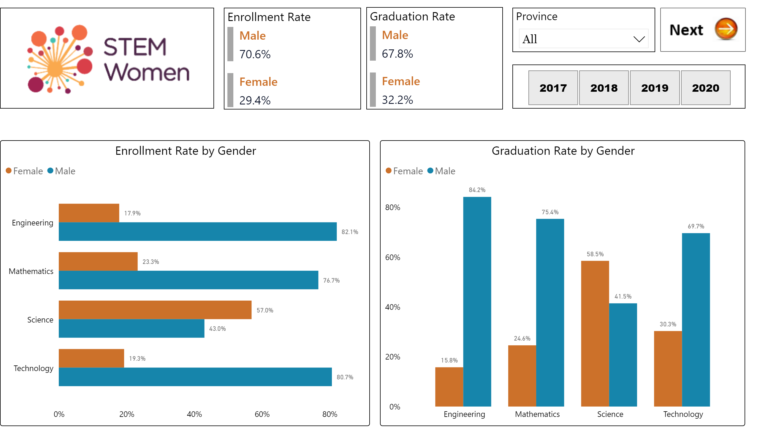
Enrollment and Graduation
Notes:
Graduation Rate by Gender
No alt text provided.
Enrollment Rate by Gender
No alt text provided.
slicer
No alt text provided.
Province
No alt text provided.
image
No alt text provided.
Enrollment Rate
No alt text provided.
Graduation Rate
No alt text provided.
actionButton
No alt text provided.

Slide 3
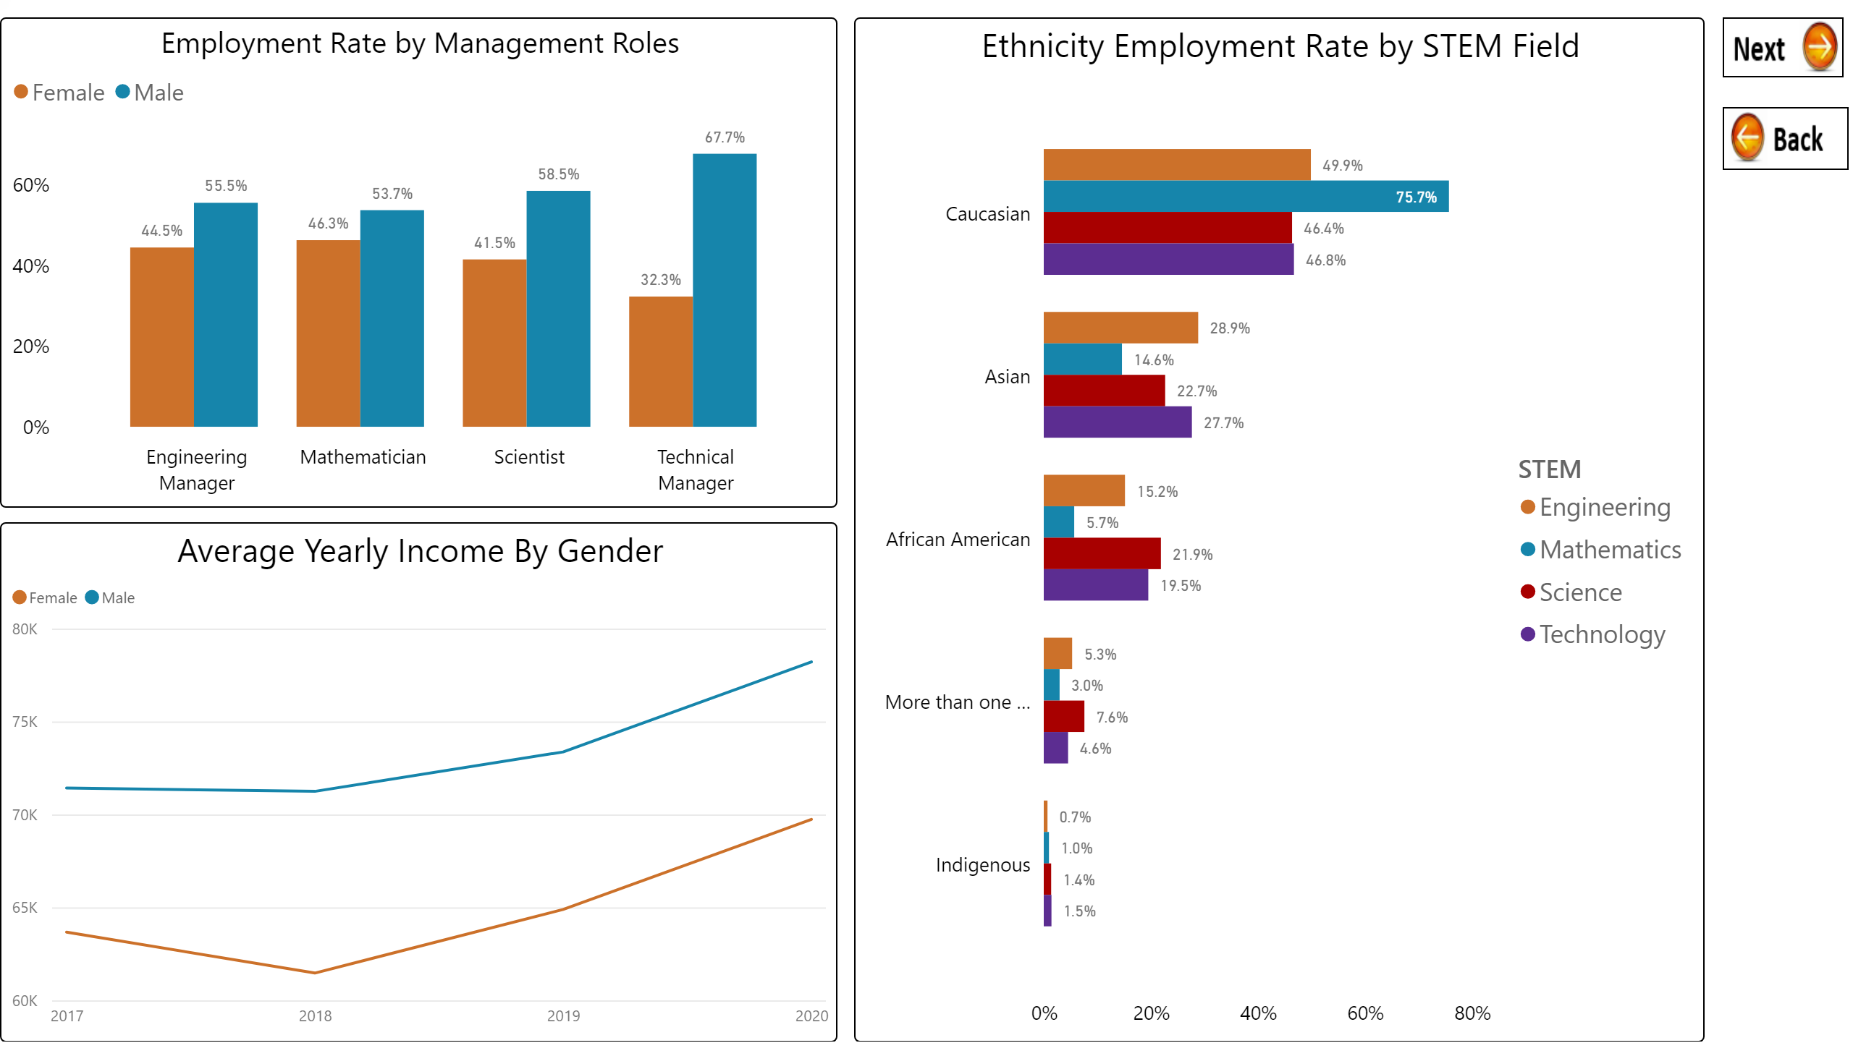
Employment

Slide 4
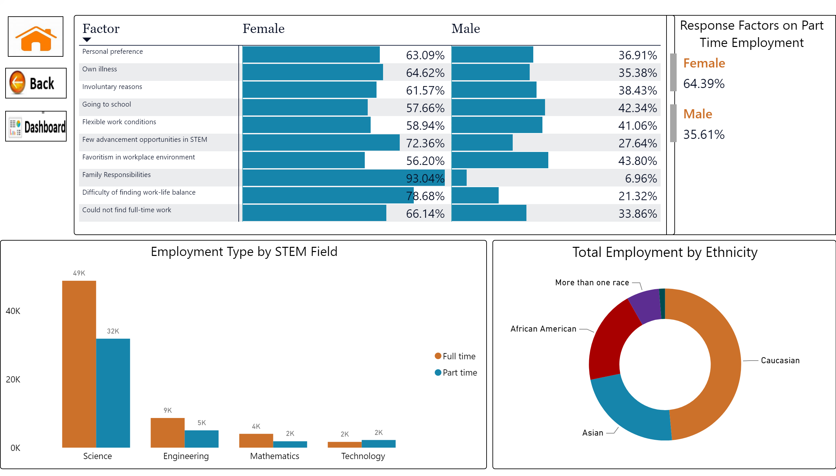
Factors and Ethnicity
Notes:
Response Factors on Part Time Employment
No alt text provided.
Total Employment by Ethnicity
No alt text provided.
Employment Type by STEM Field
No alt text provided.
actionButton
No alt text provided.
actionButton
No alt text provided.
actionButton
No alt text provided.
pivotTable
No alt text provided.

